Slide 1
DISABILITY EVALUATION
Dr. Doss Prakash Dept. of Community Physiotherapy MGM Institute of Physiotherapy CHH. SAMBHAJINAGAR

Slide 2
Disabled people are not only the most deprived human beings in the developing world, they are also the most neglected.

Slide 3
Disability Evaluation
Standard
structured
systematic and
scientific methods of evaluating disability
PRACTICAL, RELIABLE & VALID

Slide 4
Need for Disability Evaluation
Identifying needs
Matching treatments & intervention
Measuring outcomes & effectiveness
Setting priorities
Allocating resources

Slide 5
Uses for Disability Evaluation
Patient's need
Level of care
Length of hospitalization
Receipt of disability benefits
Outcome of the condition
Work performance & social integeration

Slide 6
Principles of Disability Evaluation
Functional Loss
Individual Functional Requirement
Personal Opinion
Authority
Testing Tools
When to assess
Validity of certificate

Slide 7
Section 56 of the Rights of Persons with Disabilities Act, 2016 (49 of 2016) Ministry of Social Justice & empowerment Ministry of Health & Family welfare Guidelines for disability evaluation

Slide 8
Categories
Locomotor disability including cerebral palsy, leprosy cured, dwarfism, acid attack victims &
muscular dystrophy;
Blindness and low-vision;
Deaf and hard of hearing and speech and language disability;
Intellectual disability and specific learning disabilities;
Mental illness;
Chronic neurological conditions;
Haemophilia, thalassemia and sickle cell disease; and
Multiple disabilities.

Slide 9
Disability
Permanent Physical Impairment (PPI)

Slide 10
LOCOMOTOR DISABILITY

Slide 11
LOCOMOTOR Disability
Definition
“Locomotor disability” means a person’s inability to execute distinctive activities associated with movement
of self and objects resulting from affliction of musculoskeletal or nervous system or both.

Slide 12
Guidelines for Evaluation of Permanent Physical Impairment (PPI) of Extremities
Upper Extremity
Lower Extremity

Slide 13
Guidelines for Evaluation of Permanent Physical Impairment (PPI) of Upper Extremities
The estimation and measurement shall be made when the clinical condition has reached the stage of maximum improvement from the medical treatment. Normally the time period is to be decided by the medical doctor.
The upper extremity is divided into two component parts; the arm component and the hand component.

Slide 14
UPPER EXTREMITY
ARM
Loss of ROM
Muscle strength
Coordinated activities
HAND
Prehension
Sensation
Strength

Slide 15
Guidelines for Evaluation of Permanent Physical Impairment (PPI) of Upper Extremities
Measurement of loss of function of hand component consists of determining the prehension, sensation and strength. For estimation of prehension opposition, lateral pinch, cylindrical grasp, spherical grasp and hook grasp have to be assessed.
The impairment of the entire extremity depends on the combination of the impairments of both components.
Total disability % will not exceed 100%.
Disability is to be certified as whole number and not as a fraction.
Disability is to be certified in relation to that upper extremity.ity Lower Extremity

Slide 17
1. Loss of ROM The total value of maximum ROM in arm component
90%
Shoulder – 30% Elbow – 30% Wrist – 30%

Slide 18
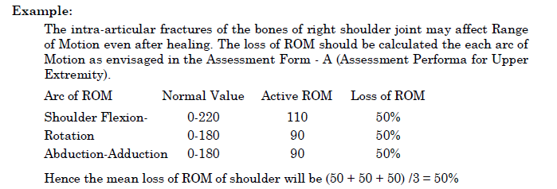
Shoulder movements constitute 30% of the Motion of the
Arm Component; therefore the loss of Motion
for Arm Component will be 50 × 0.30 = 15%.
If more one joint of the arm is involved the loss of the percentage is
Calculated separately and added together

Slide 19
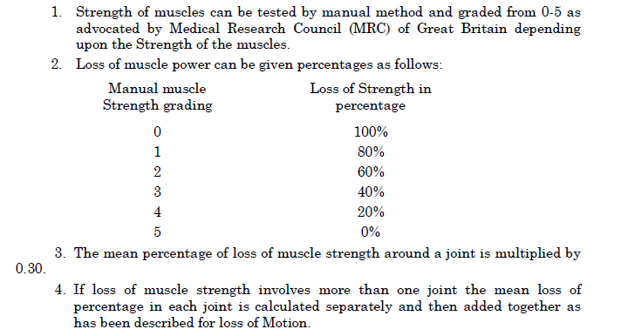
2. Muscle Strength

Slide 20
3. Coordinated activities
1. Lifting overhead objects remove and placing at the
same place 9%
2. Touching nose with end of extremity 9%
3. Eating Indian Style 9%
4. Combing and Plaiting 9%
5. Putting on a shirt/kurta 9%
6. Ablution glass of water 9%
7. Drinking Glass of water 9%
8. Buttoning 9%
9 Tie Nara Dhoti9%
10. Writing 9%

Slide 21
Combining values of arm component

Slide 22
Example
Let us assume that an individual with an intra articular fracture of bones of shoulder joint with
a) 16.5% loss of Motion in Arm,
b) 8.3% loss of Strength of muscles and
c) 5% loss of coordination.
These values should be combined as follow by using standard formula:

Slide 23
Loss of prehension – 30%
Loss of sensation – 30%
Loss of strength – 30%

Slide 24
Loss of Prehension

Slide 25
Loss of sensation

Slide 26
Loss of strength

Slide 27
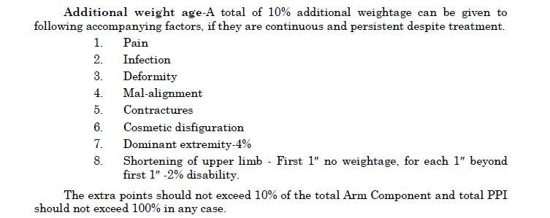
Additional 10%

Slide 28
Combining values of upper extremity

Slide 29
LOWER EXTREMITY
MOBILITY
Loss of ROM
Muscle strength
STABILITY
9 activities

Slide 30
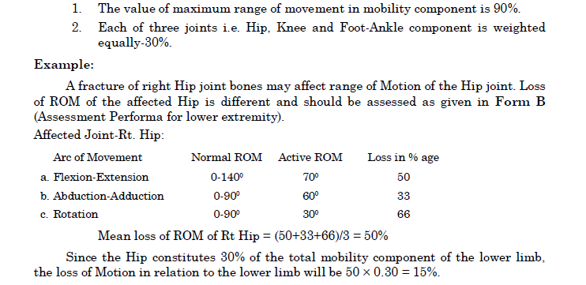
1. Loss of ROM

Slide 32
2. Muscle Strength

Slide 33
Combining values of mobility component

Slide 34
STABILITY COMPONENET
STABILITY COMPONENT (Total Value 90%)
Based on CLINICAL METHOD of Evaluation
1. Standing on both legs 10
2. Standing on affected leg 10
3. Walking on plain surface 10
4. Walking on slope 10
5. Climbing Stairs 10
6. Taking turns 10
7. Squatting on floor 10
8. Kneeling 10
9. Sitting Cross leg 10
Total 90
10% is given for complications like (i) Infection (ii) Deformity (iii) Loss of sensation.

